Slide 1

Design elements for network diagrams
CS Sprint 1 | Final Project

Slide 2
Instructions for the template
Do not change this file!
Create a copy of this file.
Use the elements from this file for your “Tempus Fugit” Project.
If you’ve deleted any icons or slides from your own copy, you can easily copy and paste necessary slides from here.
When you paste any text from another source, please use the “match destination formatting” option to keep your project’s style consistent.
Enjoy!

Slide 3
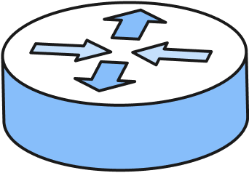
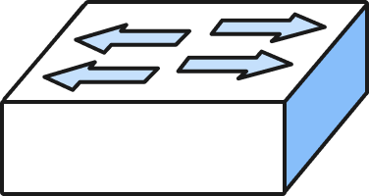
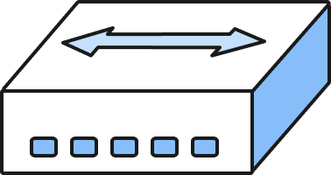
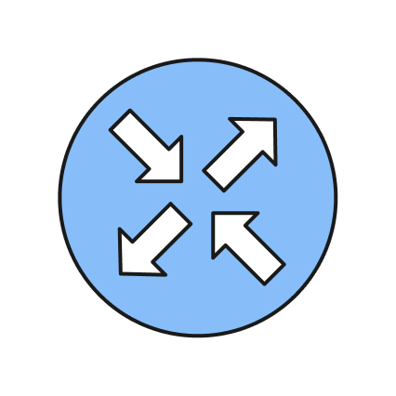
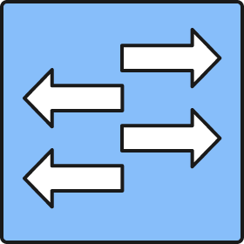
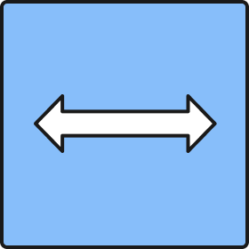

Devices
Router
Switch
Hub
If you need to make a complicated design, use these simplified icons to keep the diagram clean and readable

Slide 4
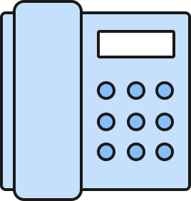
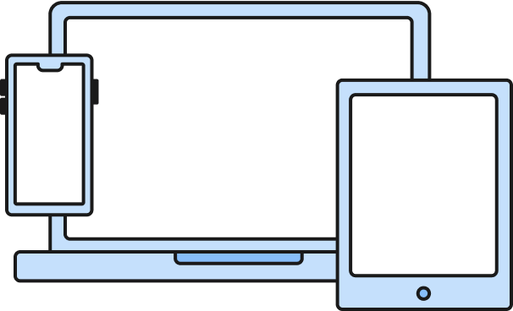

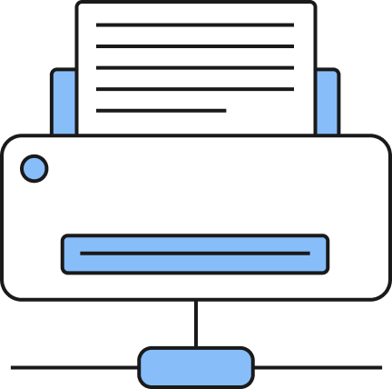
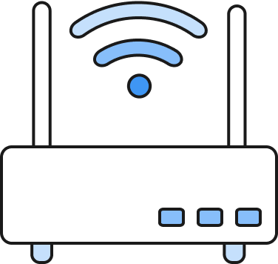
Devices
Phone
User Devices
Firewall
Wi-Fi access point
Printer

Slide 5

Topologies
Ring topology
Bus topology
Star topology

Slide 6
Topologies
Mesh topology
Hub-and-Spoke topology

Slide 7
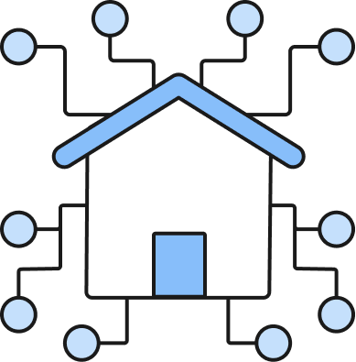
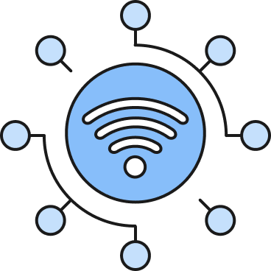

Area Networks
Internet (WAN)
Local Network (LAN)
Wireless Network (WLAN)
When you need to create connections between the networks, please use the following types of lines:
Wired network for WAN
Wired network for LAN
Wireless network for WLAN

Slide 8
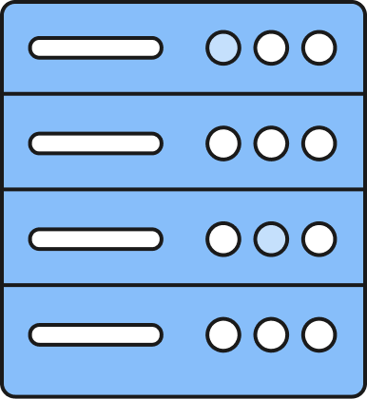

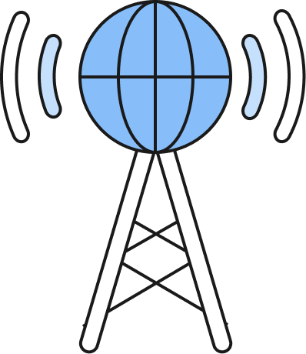
Service Providers
ISP
Data Center
Cloud Service Provider

Slide 9




Continuous Monitoring
Network Observability
Endpoint Detection & Response (EDR)
Vulnerability Scan
No visibility into network

Slide 10

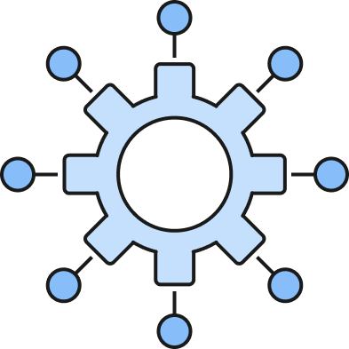
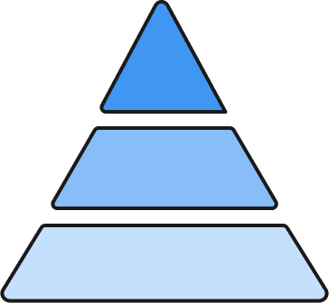
Architectures
Monolithic ERP
(Architecture)
Three-tier
(Architecture)
Cloud microservices
(Architecture)

Slide 11

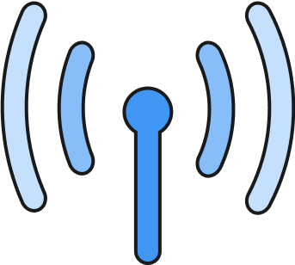

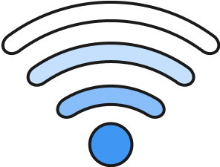
Connection Types
Wired connections
Wireless connections
High-speed Connection
Low-speed Connection
Wi-Fi Connection
Cellular Connection

Slide 12
Building A - Manufacturing
Building B - Parts Storage
Building C - Office Staff
Building D - IT Staff

Slide 13
Network Redesign
This network is best improved by first replacing each wired connection on the entire network with high speed ethernet cable. Faster fiber cable being ran from the data center to the main branching routers, including the wifi router redundancy network
Rework the endpoints in the buildings into a mesh network with a switch centerpoint to direct network traffic. They will be set up with EDRs and traffic monitors.
Separate out the phones, IoT devices, wifi routers,and printers.
The Wifi routers will have a guest network for the office staff to access the internet.
The Wifi access points in the diagram will act primarily as a redundancy network for access to every point of the network in case the wired network becomes compromised. It will allow the local building networks to access the data center and the cloud service network in case data needs to be pulled wirelessly or monitored in the event of a physical compromise or a digital attack so that threats and problems can be worked on remotely.
The data center wont be the center of the network but will be in a centralized location and protected on all sides of the main wired router by firewalls and traffic monitors. It will also have access to a cloud services network that is a backup to itself.
Each hop on the network will also have firewalls watching traffic entering and exiting the hop.
The traffic leaving and entering the main router at the bottom will be firewalled as well to block malicious threats entering the network and block sensitive data from leaving the data center.
These improvements will ultimately be put in place to maximize security, allow for accessibility across every department, increase overall speed, and allow for multiple ways for troubleshooting threats or breakdowns of any hop of the network.

